Slide 1
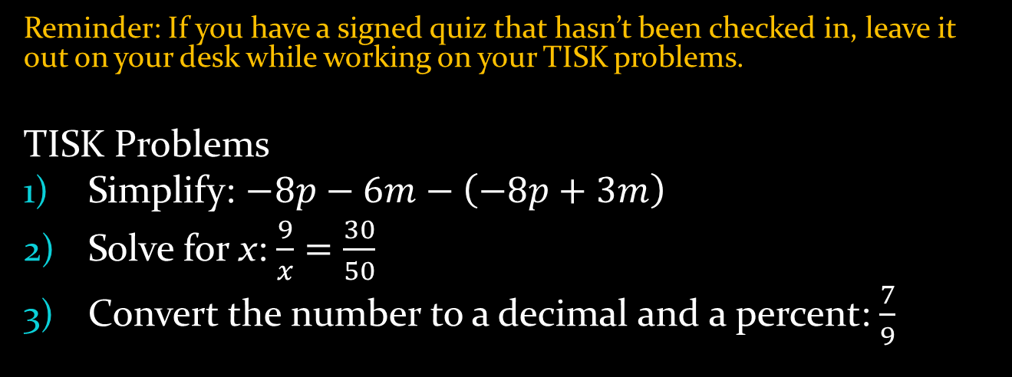
Wednesday, October 31, 2012
Reminder: If you have a signed quiz that hasn’t been checked in, leave it out on your desk while working on your TISK problems.
TISK Problems
Simplify: $−8p−6m−\left(−8p+3m\right)$
Solve for x: $\frac{9}{x}=\frac{30}{50}$
Convert the number to a decimal and a percent: $\frac{7}{9}$
No Mental Math today.
Homework: 9-8 Worksheet OR Finish your write-up (** your choice)

Slide 2

Homework Check
$P(A)∙P(B)$
$P(A)∙P(B given A)$
Answers will vary.
Answers will vary.
$\frac{1}{15}$
$\frac{1}{6}$
$\frac{3}{11}$
$\frac{4}{21}$
Dependent; $\frac{5}{39}$
Independent; $\frac{11}{80}$ or 13.75%
$\frac{1}{49}$
(a) $\frac{1}{22}$ (b) $\frac{6}{11}$

Slide 3
§9-8 Odds
Odds are another way of expressing probability.
Odds compare probabilities using ratios
Odds are either in favor or against an event
To calculate the odds in favor of an event…
Number of favorable outcomes : number of unfavorable outcomes
To calculate the odds against an event….
Number of unfavorable outcomes : Number of favorable outcomes

Slide 4
§9-8 Odds
Calculate the odds in favor of spinning a multiple of 3.
Favorable Outcomes:
1
Odds in Favor of a Multiple of 3
3:7
10
2
3
6
9
9
3
Number of Favorable Outcomes:
8
4
3
7
Unfavorable Outcomes:
5
6
1
2
4
5
7
8
10
Number of Favorable Outcomes:
7

Slide 5
§9-8 Odds
Key Idea:
Possible Outcomes = Favorable Outcomes + Unfavorable Outcomes
You have a fair 20-sided die. Find the odds against rolling a prime number.
Favorable Outcomes:
2
3
5
7
11
13
17
19
Number of Favorable Outcomes = 8
Unfavorable Outcomes:
Number of Unfavorable Outcomes = 12
I don’t want to list them all… how many possible outcomes are there?
Odds against rolling a prime number:
12:8
20
3:2
Since there are 20 possible and 8 favorable, there must be 20 – 8 = 12 unfavorable outcomes.
Wait! Ratios can be reduced just like fractions!

Slide 6
§9-8 Odds
You try it
Find the odds in favor of spinning blue.
Odds in favor of blue
1:3

Slide 7
§9-8 Odds
If the probability of a certain event occurring is what are the odds in favor of the event?
To calculate the odds in favor of an event…
Number of favorable outcomes : number of unfavorable outcomes
3
:
2
5 = 3 + x
Possible Outcomes = Favorable Outcomes + Unfavorable Outcomes

Slide 8
§9-8 Odds
If the probability of an event occurring is 24%, what are the odds against it occurring?
Favorable: 24
Unfavorable:
100 – 23
=76
Odds Against the Event
76:24
19:6

Slide 9

§9-8 Odds
If the odds against an event are 12:5 what is the probability the event will occur?
Favorable: 5
Unfavorable:
12
Total Possible Outcomes:
12+5 = 17
P(event) = $\frac{5}{17}$

